Slide 1
운용 매뉴얼

Slide 2
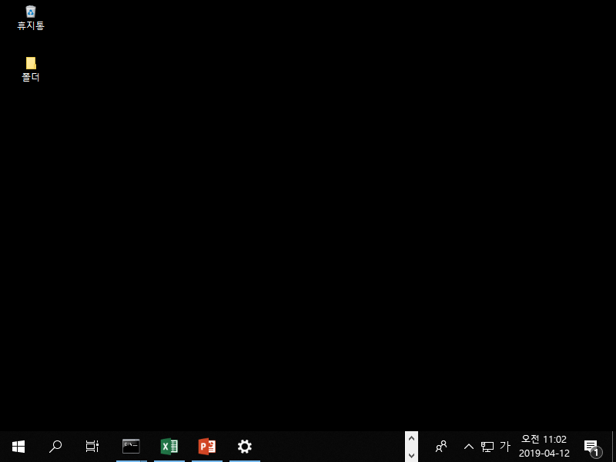
1. Folder access (Auto 1~2)

Slide 3
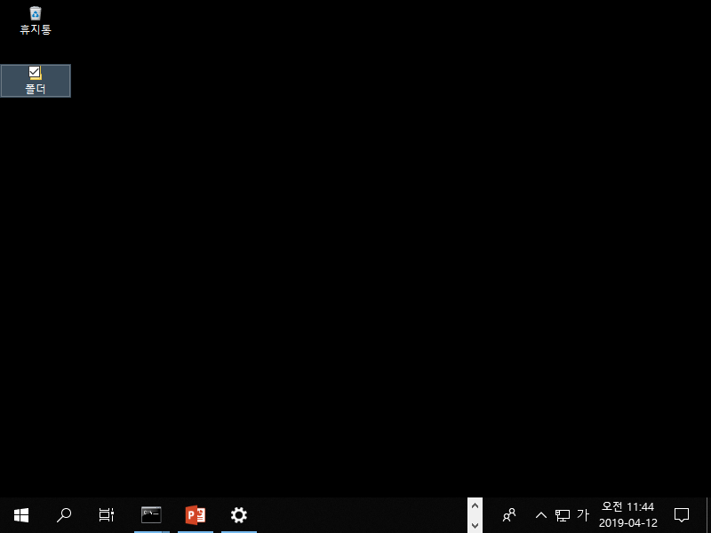
1. Folder access (Auto 1~2)

Slide 4
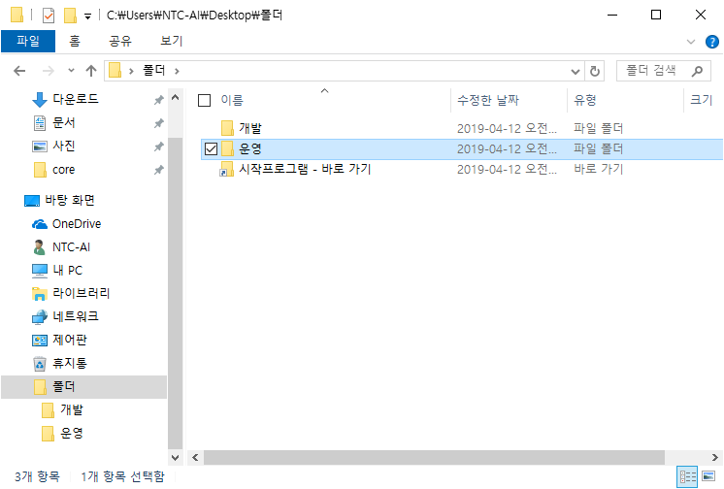
1. Folder access (Auto 1~2)

Slide 5
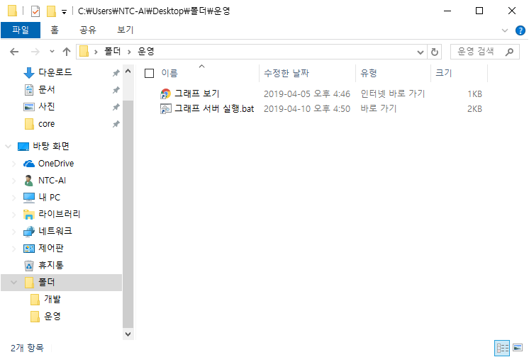
1. Folder access (Auto 1~2)

Slide 6
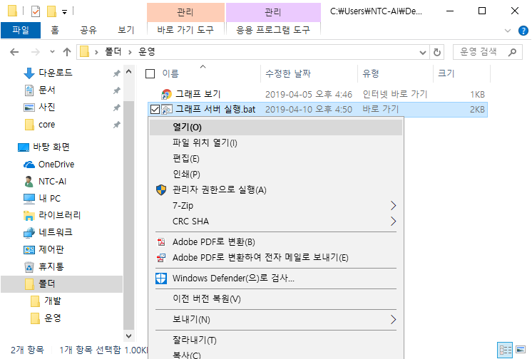
2. Start server (Auto 1~2)

Slide 7
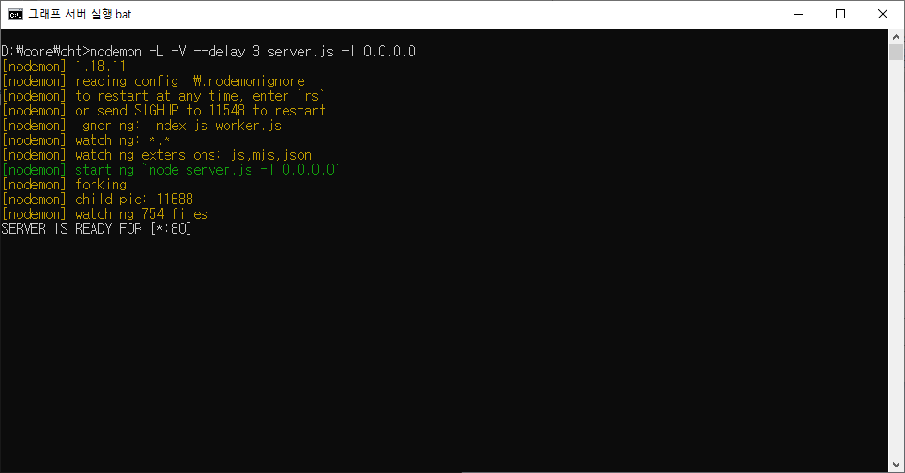
2. Start server (Auto 1~2)
Notes:
cmd : nodemon –L –V –delay 3 D:\core\cht\server.js –l 0.0.0.0

Slide 8
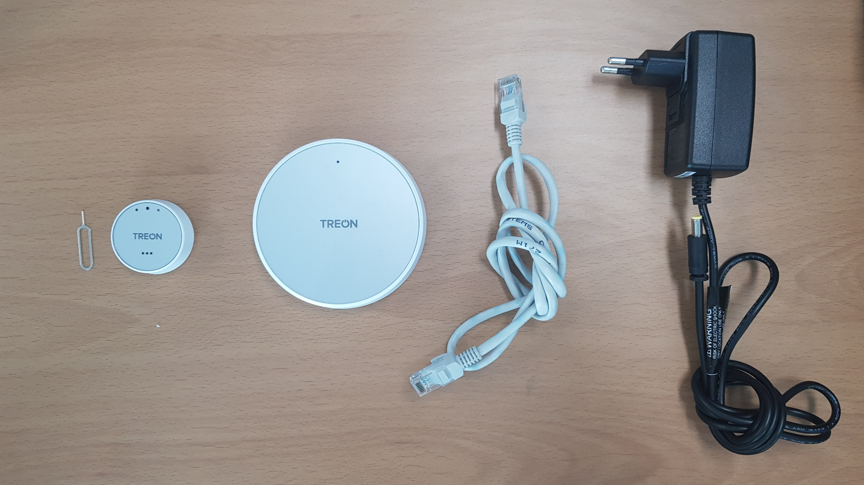
3. Start gateway
Notes:
(1) sensor node clip, (2) sensor node, (3) gateway, (4) LAN cable, (5) power adapter for gateway

Slide 9
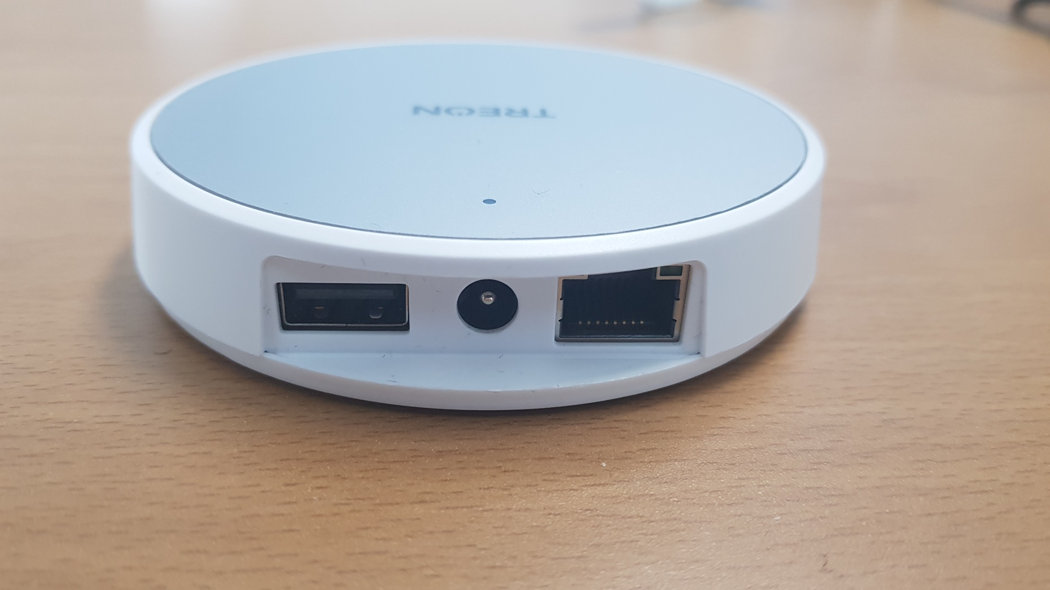
3. Start gateway
Notes:
ports beside back of gateway

Slide 10
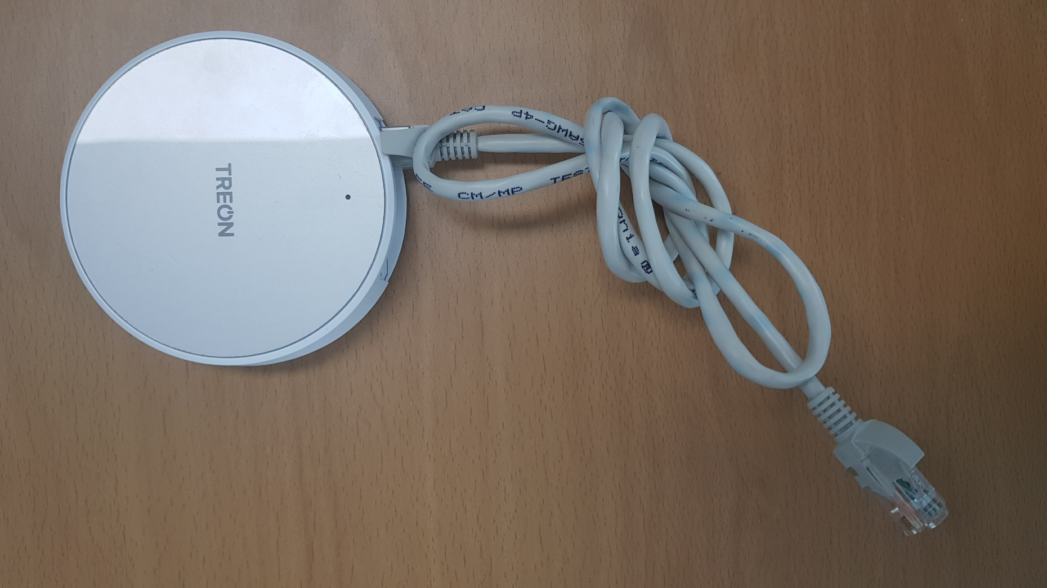
3. Start gateway
Notes:
put (4) LAN cable into the (3) gateway

Slide 11
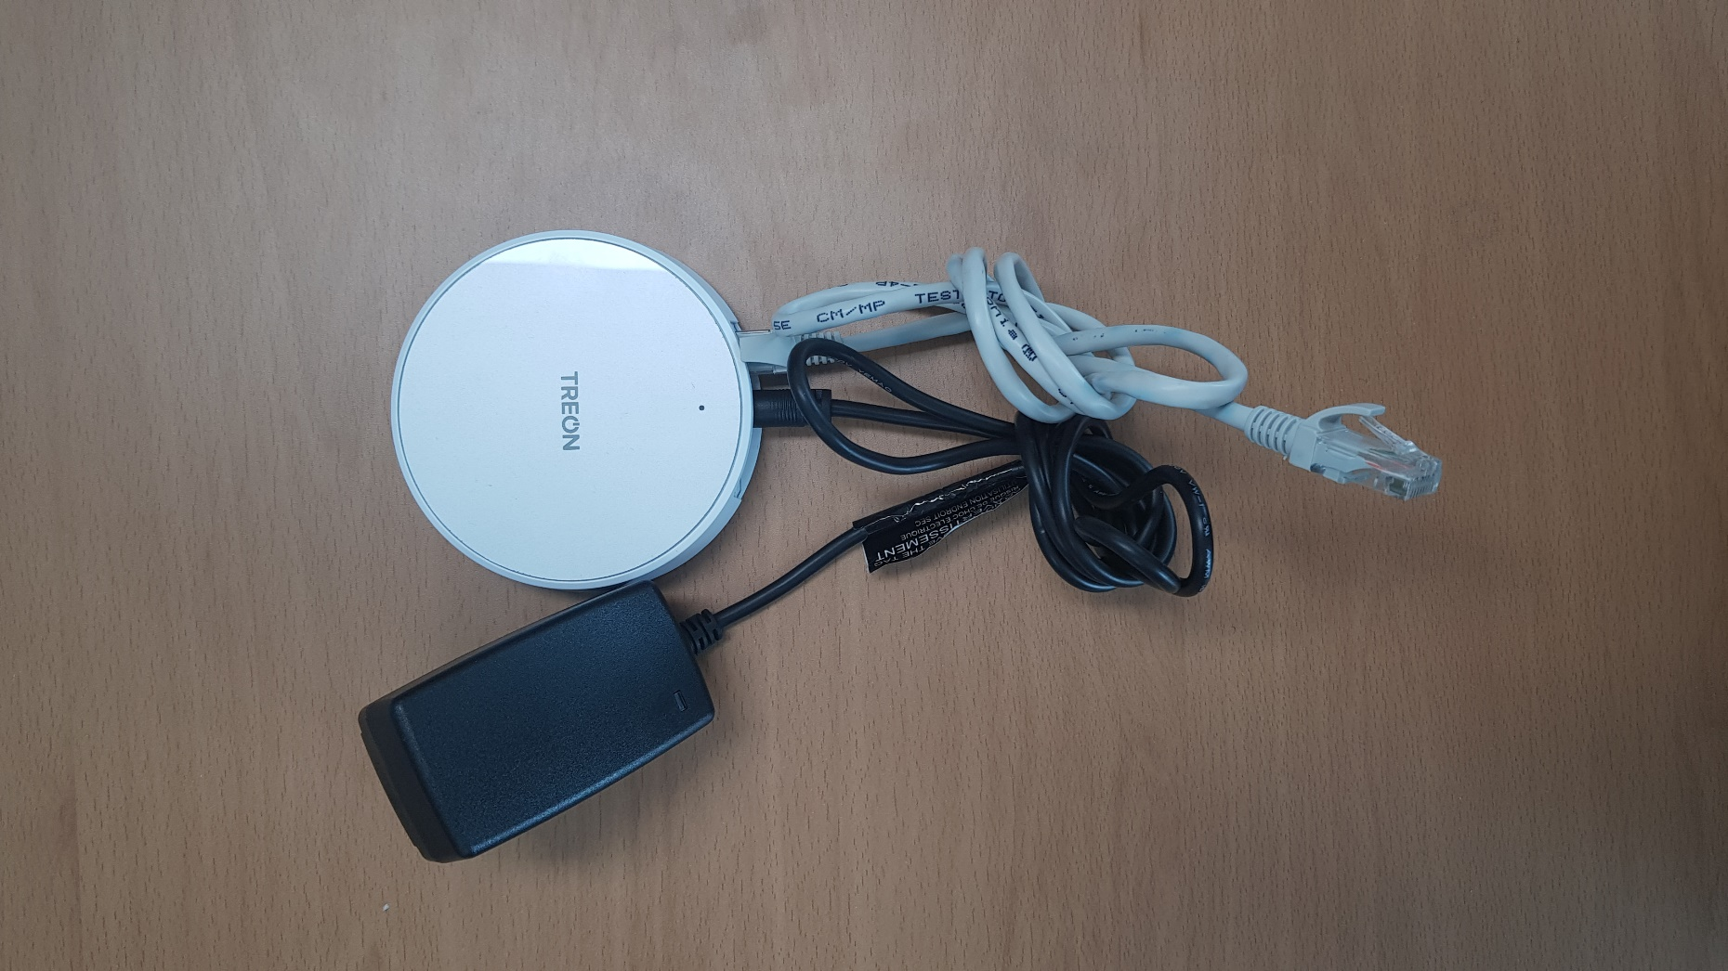
3. Start gateway
Notes:
put (5) power adaptor into the (3) gateway

Slide 12
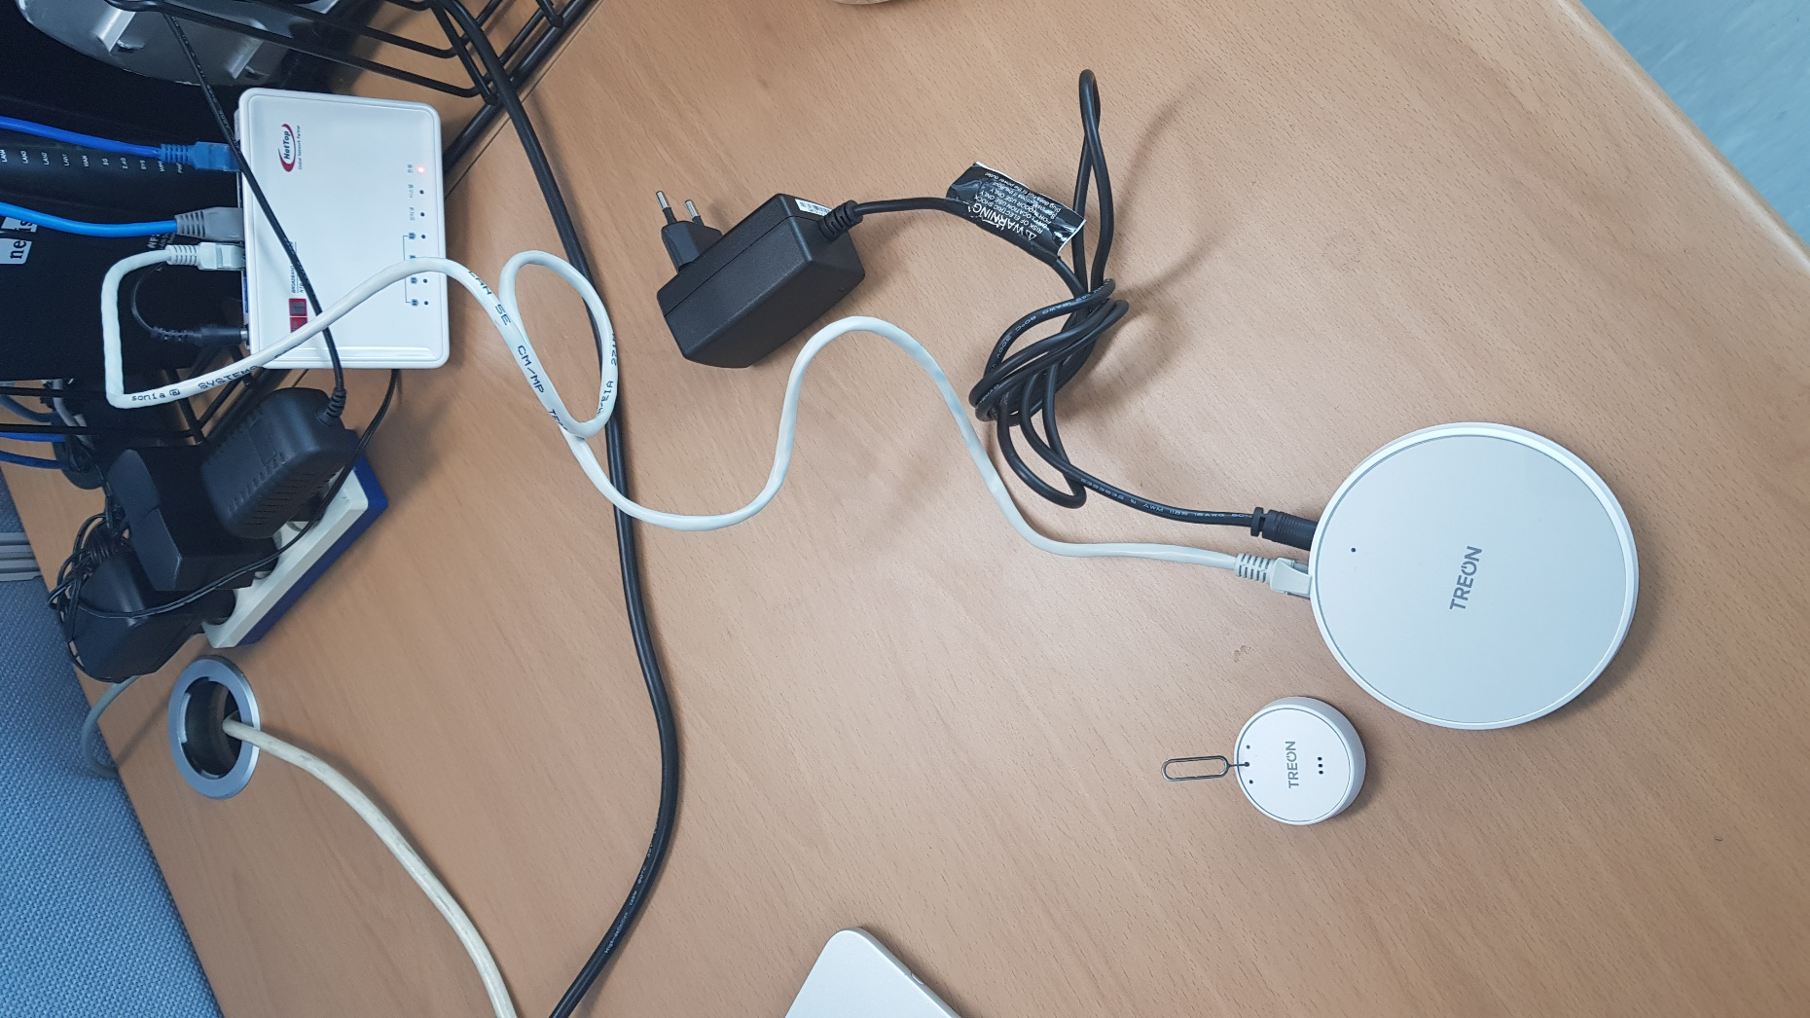
3. Start gateway
Notes:
put LAN cable into router

Slide 13
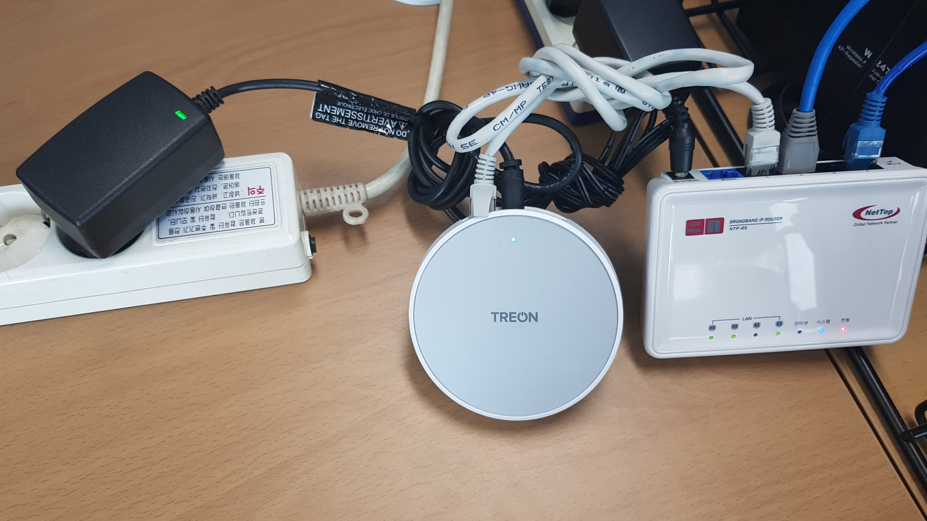
3. Start gateway
Notes:
put adaptor into consent. LED light will cyan at first

Slide 14
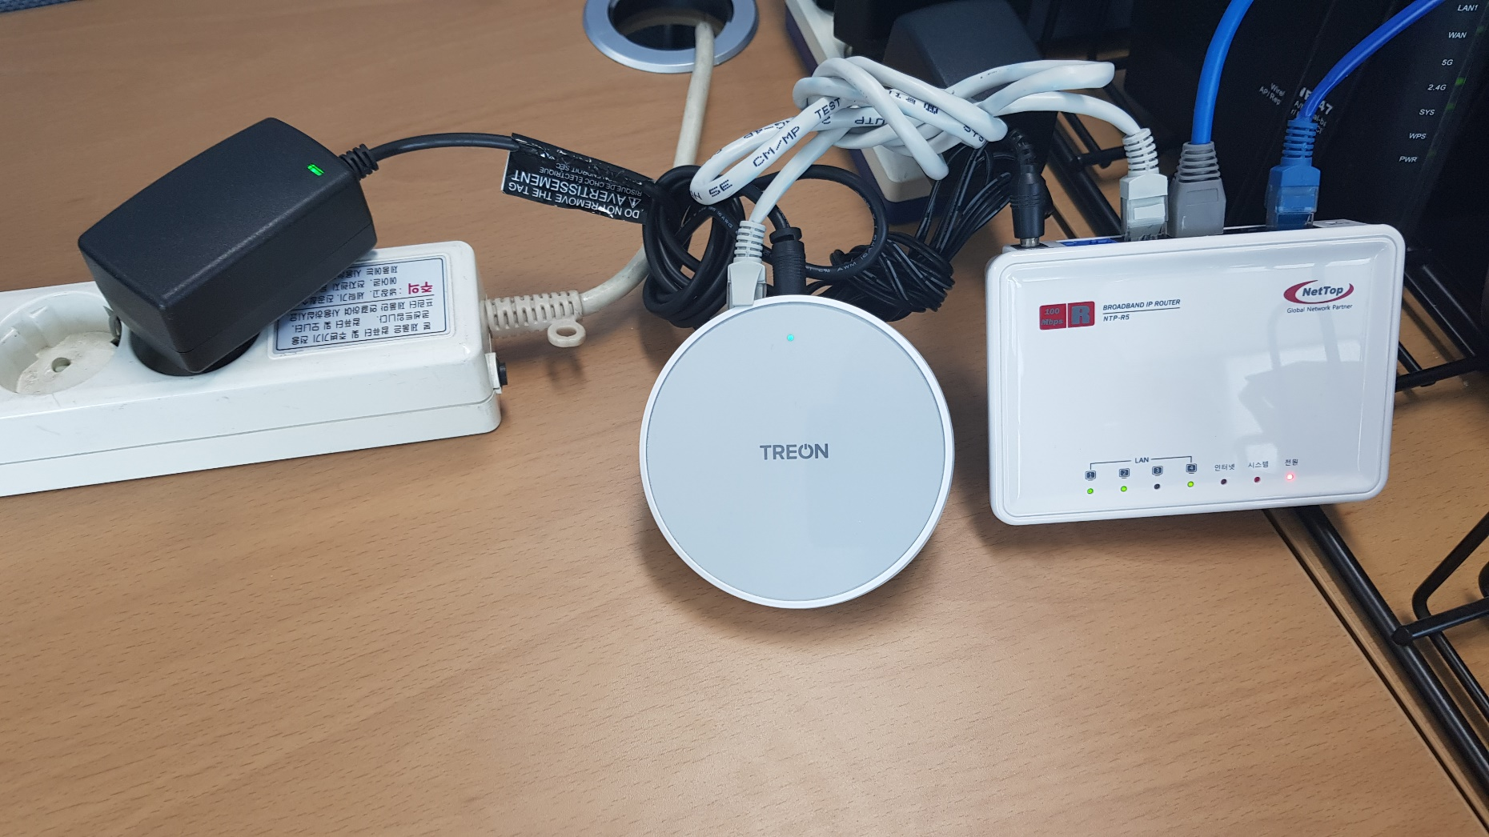
3. Start gateway
Notes:
wait until LED light become green. gateway data sender will be run by system automatically.

Slide 15
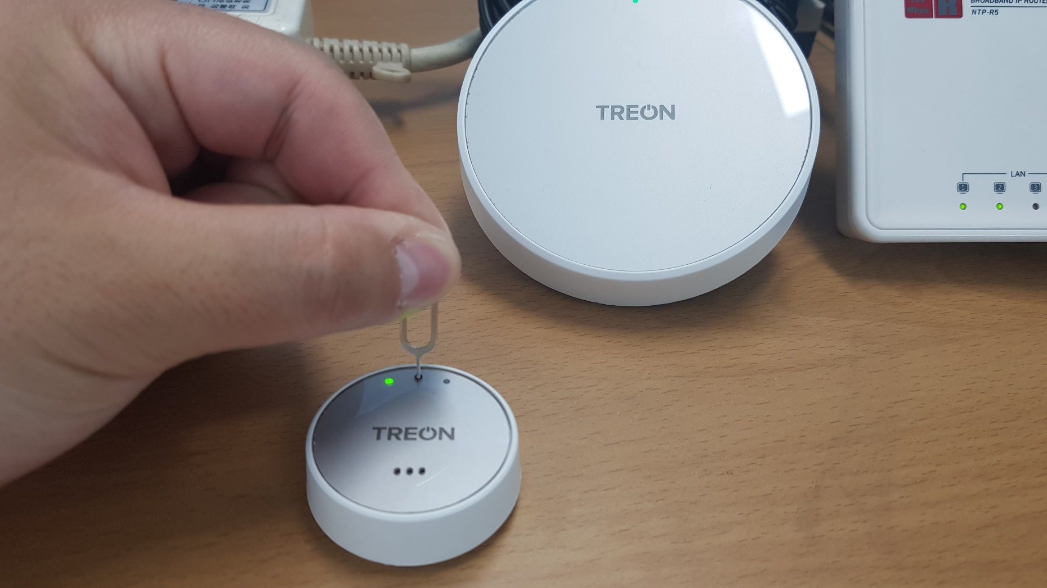
3. Start gateway
Notes:
put (1) sensor node clip into (2) sensor node’s center hole until LED light become green. there is power switch

Slide 16
4. Start client

Slide 17
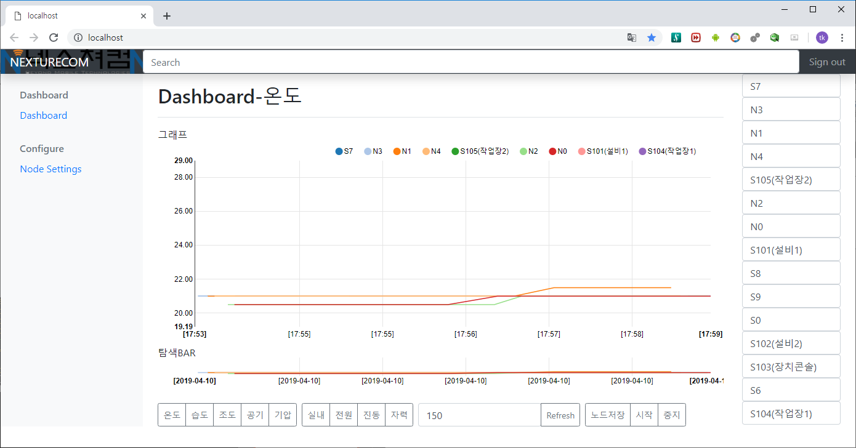
4. Start client

